Slide 1
Adoption and use of common standards for Scotland’s data strategy
Solmaz Eradat Oskoui 5th April 2024

Slide 2
Overview
1
Data Harmonise Ltd
2
Interoperability & Information Standards
3
Scotland’s Health Data Sharing Landscape
4
OMOP CDM Overview
5
PoC for Data Harmonisation Strategy

Slide 3



Professional
Applied Mathematics, PhD
St.Andrews University
Consultant/Senior Data Analyst/Data Engineer
Academia/IT/Financial Services/Health Informatics
Founder
Data Harmonise Ltd
2014
2014 - 2023
2024

Slide 4
Company Mission
Advance interoperability and quality within healthcare data by providing data standardisation and engineering solutions leveraging the Observational Medical Outcomes Partnership Common Data Model (OMOP-CDM). Our commitment is to facilitate data links, foster collaboration, accelerate research outputs, and drive innovation.

Slide 5
Interoperability & Information Standards

Slide 6
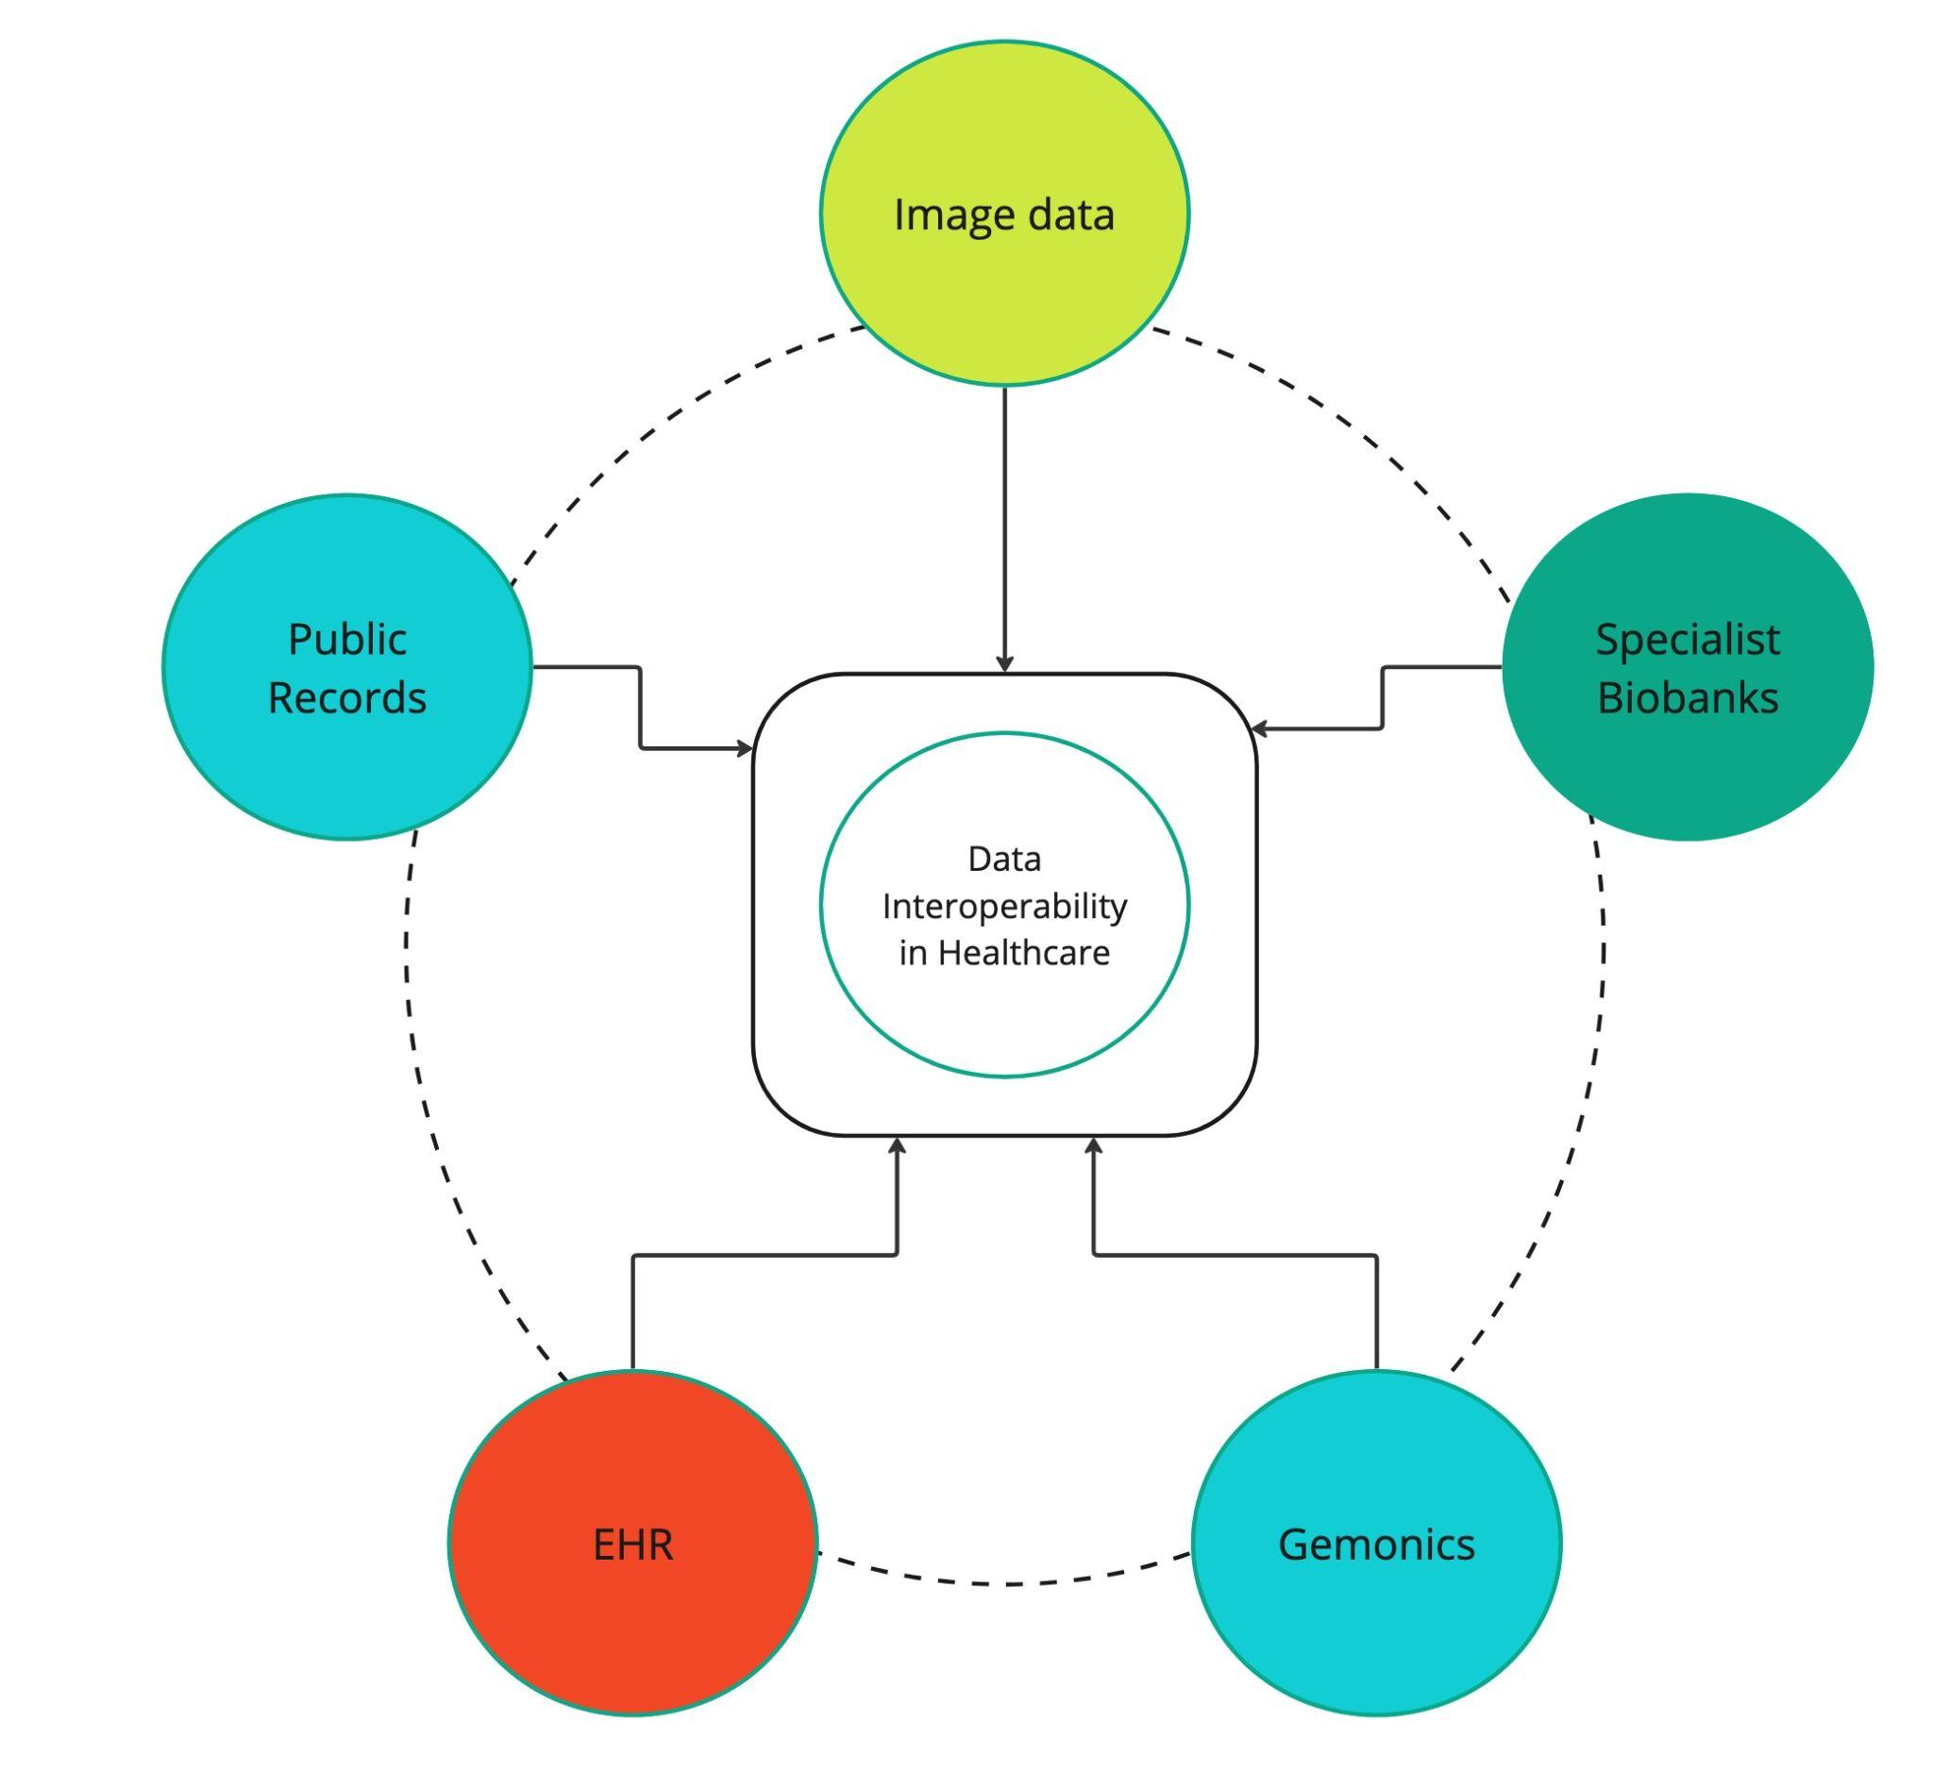
What is data Interoperability?
Healthcare data can vary greatly both in structure and terminologies from one organisation to the next.
Data are collected for different purposes, stored in different formats using different database systems and information models.
To improve the interoperability of health data requires standardising both the structure (syntactic interoperability) and the terminologies (semantic interoperability).

Slide 7
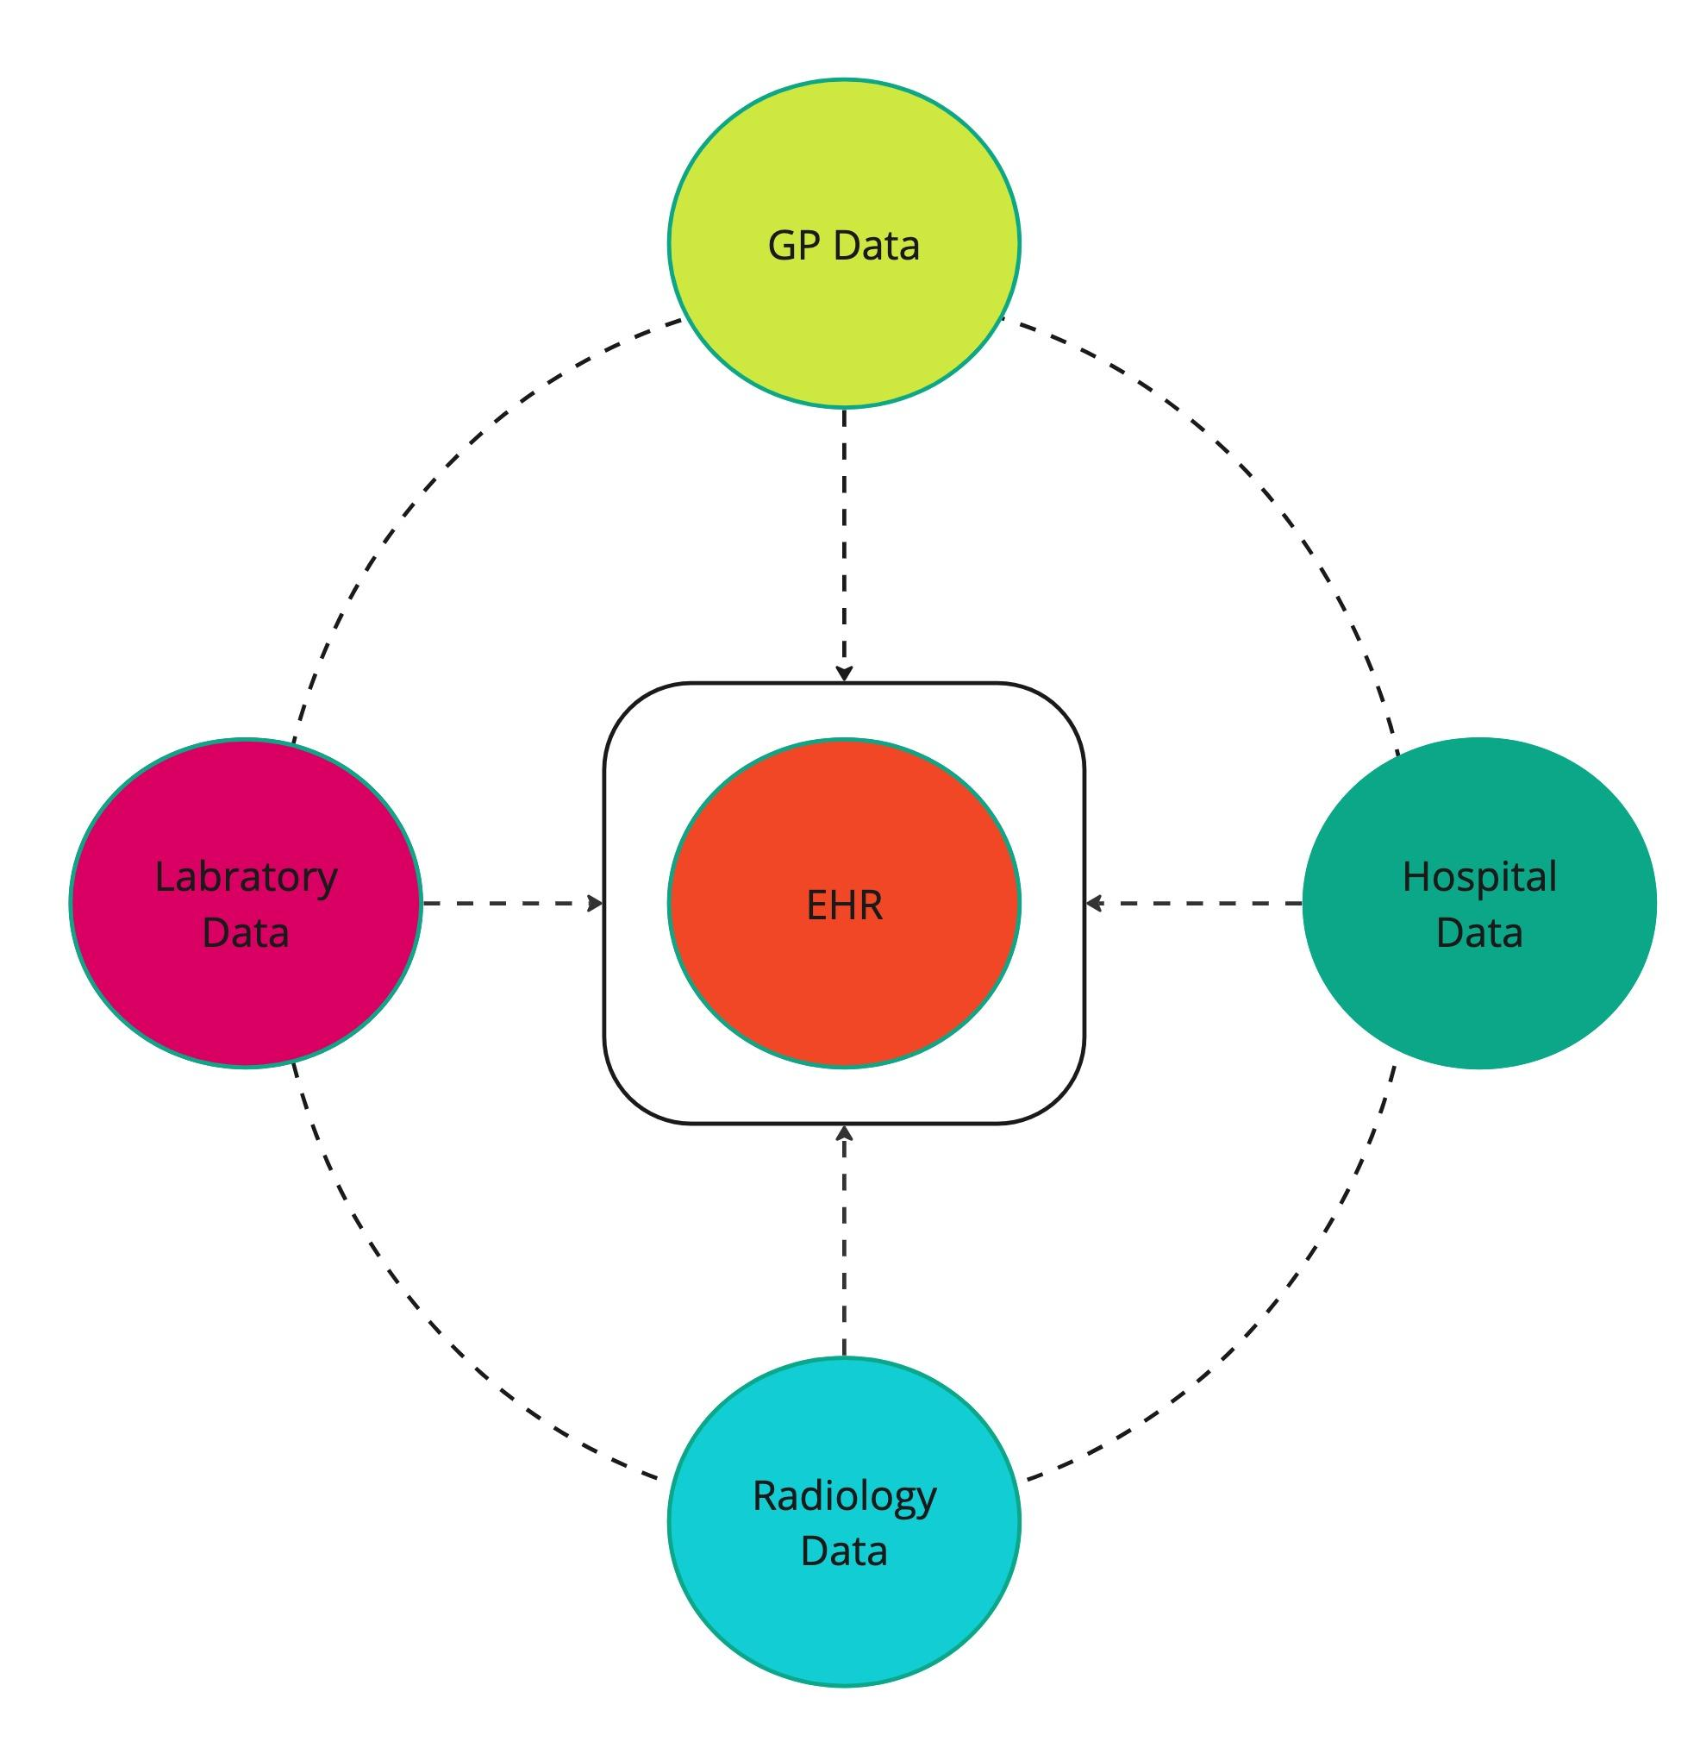
Take EHRs for example …
Centralised Patient Data: Electronic Health Records (EHRs) store a patient's comprehensive medical history in one place, including demographics, medical history, clinical notes, radiology data, laboratory results, and more.
Information Exchange: EHRs can receive and exchange patient data with various healthcare providers: GPs, hospitals, radiology departments, and laboratories.
Standardised Communication: To ensure seamless communication and data exchange between different healthcare systems (often from different vendors), there is a need for common standards!

Slide 8
Focus of each Standard
DICOM (Digital Imaging and Communications in Medicine): A standard focusing on data exchange and data persistence (structure, storage, maintenance) for medical images (X-rays, MRIs, CT, ultrasound, etc.).
HL7 FHIR (Fast Healthcare Interoperability Resources): A standard focusing on data exchange and data persistence (structure, storage, maintenance) of EHRs in real time between healthcare systems.
openEHR (open Electronic Health Record): A standard focusing on data persistence (structure, storage, maintenance) and data exchange for EHRs.
PRSB (Patient Reported Symptoms Burden): A standard focusing on capturing and coding patient-reported symptoms and their impact on daily life, typically gathered through standardised questionnaires or surveys.
OMOP CDM (Observational Medical Outcomes Partnership Common Data Model): A standard focusing on structure and terminology to facilitated the integration of data from different EHR systems for the purpose of large-scale research studies.

Slide 9
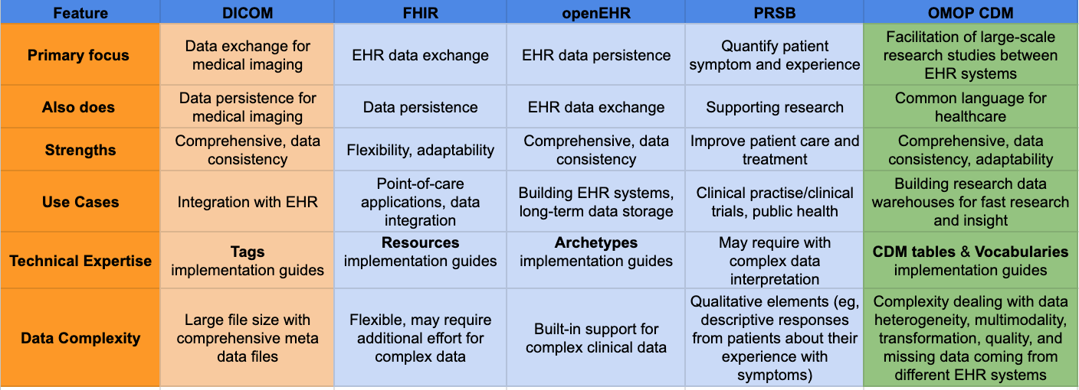
Comparison between standards
DICOM works a little differently with OMOP compared to FHIR, openEHR, and PRSB.

Slide 10
How do common data models like DICOM, FHIR, openEHR & PRSB work with OMOP for research?
1. FHIR, openEHR & PRSB:
These three standards work collaboratively to provide data for OMOP research:
FHIR (Fast Healthcare Interoperability Resources): Enables real-time clinical data exchange between healthcare systems. Data from FHIR can be used to populate openEHR-based Electronic Health Records (EHRs).
openEHR (open Electronic Health Records): Provides a standardised way to manage and store comprehensive clinical data in EHRs. This data captured during routine care is a valuable source for research using OMOP.
PRSB (Patient Reported Symptoms Burden): PRSB questionnaire/survey designed with FHIR and openEHR standards in mind, potentially can be integrated with OMOP to enrich research on symptom impact.
How they work with OMOP:
Data Source: Data from openEHR and FHIR enabled systems becomes a source for OMOP research.
Transformation and Mapping: After addressing heterogeneity and data quality issues in the EHR data, data is transformed and mapped to the OMOP CDM.
Fast Research: Once transformed, the data becomes usable for large-scale research analysis using OMOP tools. Researchers can then investigate trends, treatment effectiveness, and patient experiences in a quicker and collaborative way.

Slide 11
How do common data models like DICOM, FHIR, openEHR & PRSB work with OMOP for research?
2. DICOM (Digital Imaging and Communications in Medicine):
Focus: DICOM is specifically designed for exchanging medical images (X-rays, MRIs, CT scans, etc.) and associated data electronically.
How DICOM work with OMOP:
Integration of imaging data aligned to the OMOP CDM has been purposed and awaiting feedback.
This extension adds two new tables, designed to capture detailed information about imaging events and features with their provenance.
Integrating imaging features with OMOP CDM unlocks a wealth of data for researchers, leading to more comprehensive studies.

Slide 12
Standards working together for better local, national and international healthcare understanding …
Clinical data standardised to FHIR, OpenEHR, PSRB and DICOM provide a comprehensive data source for clinicians to provide better patient care.
Transforming this standardised data to the OMOP CDM allows large scale research to be conducted from local, national and international EHR systems, providing better healthcare insights and better decision making.

Slide 13
Scotland’s Health Data Sharing Landscape

Slide 14
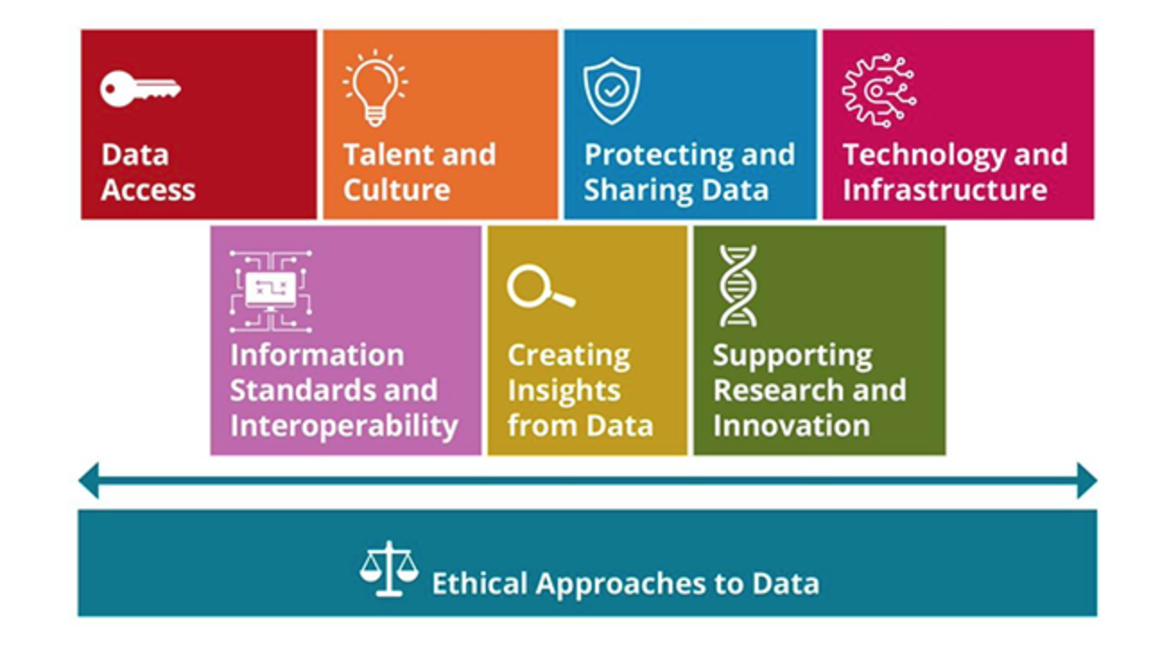
Health & Social Care Data Strategy
First Data Strategy for Health and Social care focusing
On areas:
Data Access
Talent and Culture
Protecting and Sharing Data
Technology and Infrastructure
Information Standards and Interoperability
Creating Insight from Data
Supporting Research and Innovation
Through the Cloud Platform Seer, long term ambition to improve data quality and create data links, enabling frontline and social care professionals to make better patient care decisions in a secure, transparent and ethical manner.
Health and social care: data strategy - executive summary

Slide 15
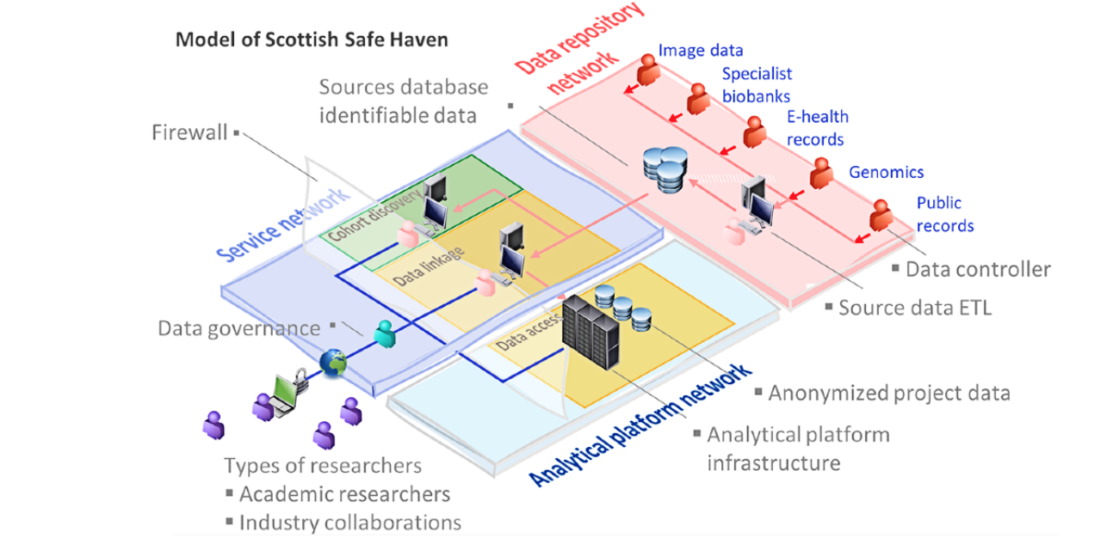
Safe Havens in Scotland
Network of 5 Safe Havens has been established to support:
Data discovery and research feasibility
Indexing and linkage
Cohort Building
Analytical support and archive
Safe Havens make use of two networks:
Data repositories set up mainly on NHS networks.
Analytical platform set up within university-managed networks
“Provides secure analytics platforms for researchers to access linked, deidentified electronic health records (EHRs) while managing the risk of unauthorised reidentification.”
A National Network of Safe Havens: A Scottish Perspective (Preprint)
ETL = EXTRACT, TRANSFORM, LOAD

Slide 16
Using a Common Data Model in Safe Havens?
“If common data models (CDM) such as Observational Medical Outcomes Partnership (OMOP) and i2b2 star schema were used, either for data repositories or analytical platforms, the burden on multi–Safe Haven projects would be reduced, and operational access to data would be faster and more predictable.”

Slide 17
OMOP CDM Overview

Slide 18
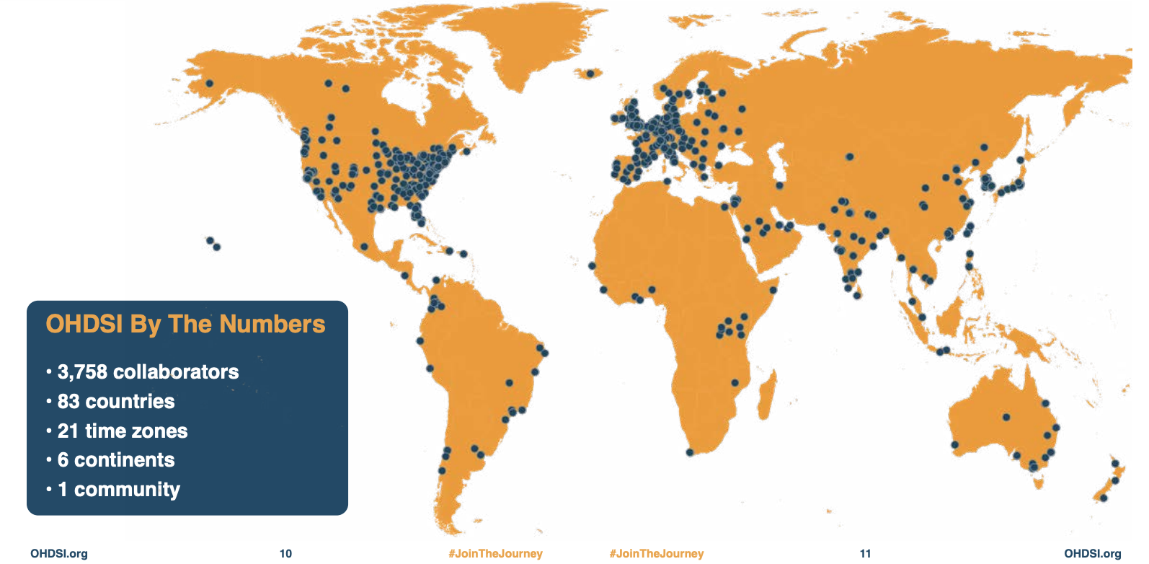
What is the OMOP-CDM?
Goal: The Observational Health Data Sciences and Informatics (OHDSI) a multi-stakeholder, interdisciplinary community that is striving to bring out the value of observational health data through large-scale analytics.
Method: Created a standardised data model the Observational Medical Outcomes Partnership Common Data Model (OMOP-CDM)
Impact:
Growing adoption over 10 years
534 data sources from 49 countries mapped
Represents 956 million patients (12% of world population)
Where the OHDSI community has been and where are we going Annual report 2023

Slide 19
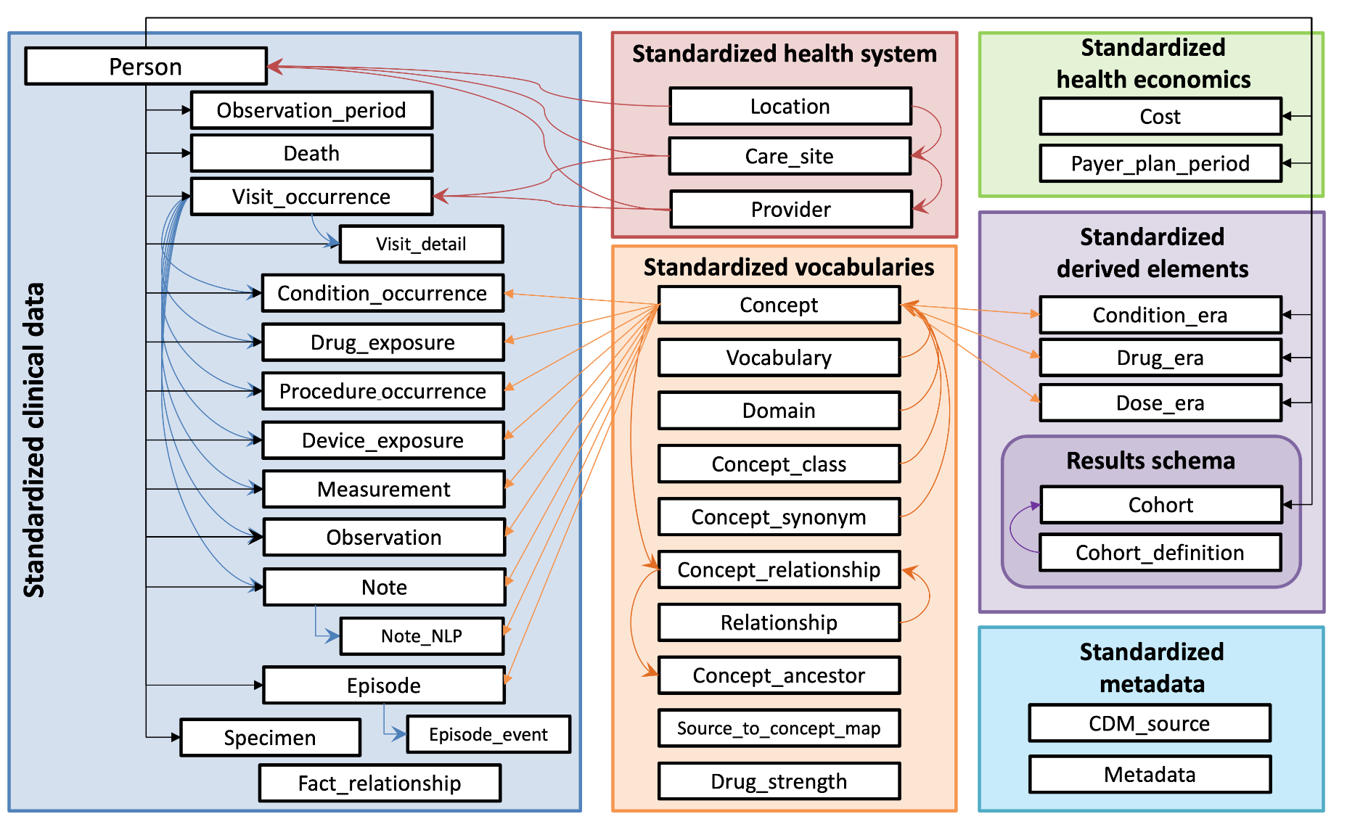
Adopting the OMOP-CDM
OMOP-CDM used to link Observational healthcare databases.
Key features:
Patient-centric
Tabular/Relational Design
Standardised Vocabulary
Extendable
Built for Collaborative Analytics
It’s benefits can also extend to planning and population health management
OMOP-CDM V.5.4

Slide 20
Benefits of adopting the OMOP-CDM
Open-source and Collaborative:
Actively developed and maintained tools on Github with a supportive community forum.
Offers guidance and assistance for general and specific data conversion questions.
Standardised Representation:
Creates a common language for healthcare data, simplifying researcher understanding.
FAIR Data Principles:
Supports Findability, Accessibility, Interoperability, and Reusability of data.
Benefits researchers and healthcare technology development for better patient and population health decisions
Large-Scale Datasets:
Enables creation of large, standardized datasets for national and international federated network studies.

Slide 21
Challenges when adopting the OMOP-CDM
Data Dictionary Effort:
Requires well-defined source data dictionaries, which can be resource-intensive to create and maintain.
Conversion Time:
First iteration of mapping typically takes 6-12 months to complete.
Technical Considerations:
Setting up and governing data, especially with PII (Personally Identifiable Information), can lead to delays.
Expert Input:
Conversion requires input from clinical experts familiar with the source data.
Ongoing Maintenance:
Regular updates are needed to adapt to changes in source data, data models, and vocabularies.

Slide 22
PoC for Data Harmonisation Strategy

Slide 23
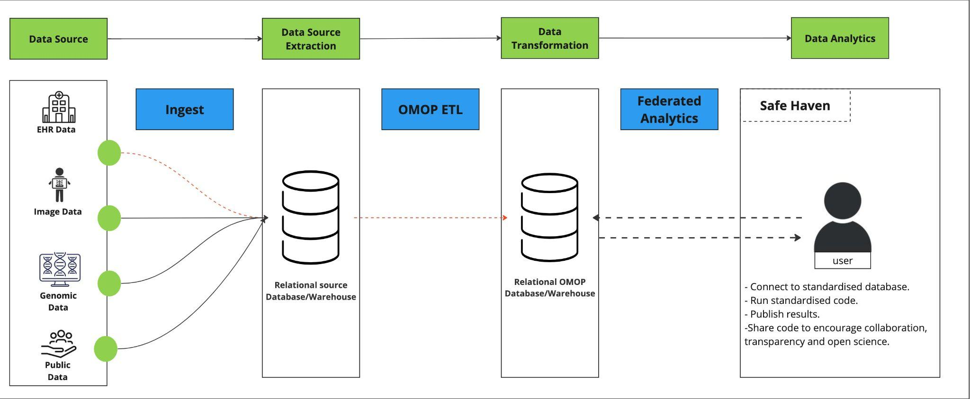
Standardising within data repository
OMOP ETL carried out on NHS network

Slide 24
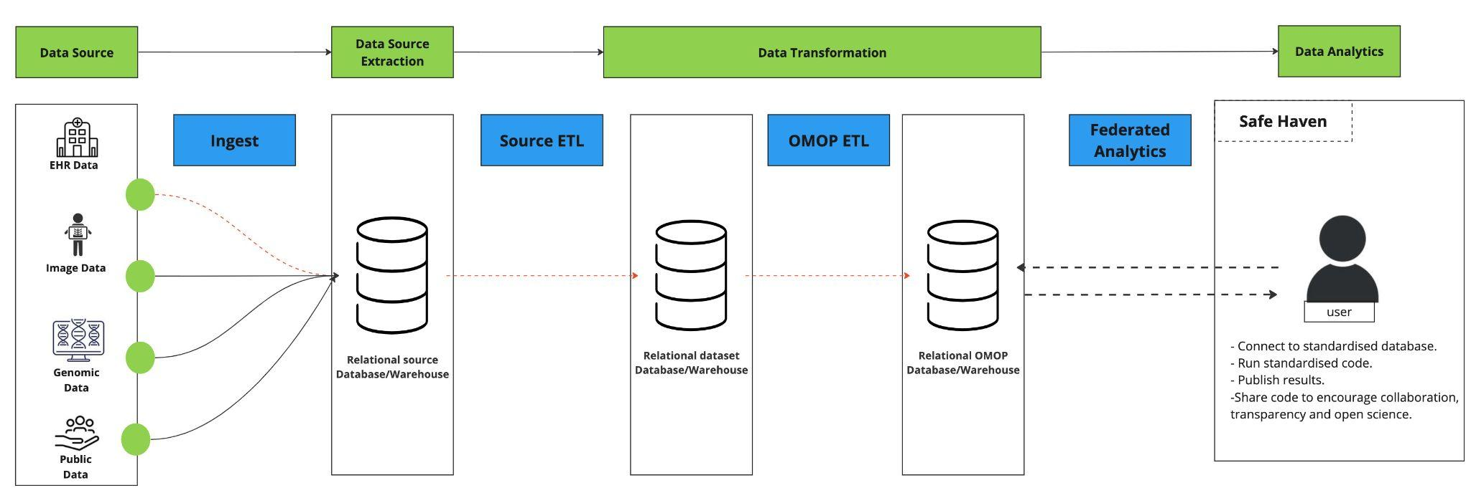
Standardising within analytical platform
OMOP ETL carried out analytical platform

Slide 25
Possible areas to work Together
1 - Data interoperability workshops:
Education and upskilling through bringing awareness to the use and benefit of standards such as the OMOP-CDM.
2 - Data engineering services using OMOP-CDM:
Mapping a subset of data within a NHS network which has not converted data to OMOP-CDM
Mapping a subset of data within an analytical repository that has not been covered the OMOP-CDM
3 - Testing a Proof Of Concept (PoC) using OMOP-CDM:
Building ETL pipelines for the subset and sharing learning with directorates to support the data strategy plan
4 - Expanding the concept to other data sources:
Scaling up the pipelines to look at imaging, genomics, social care, other local authorities data.

Slide 26
Thank you for listening!

Slide 27
Useful Links
Health and social care: data strategy - executive summary
NHS Research SDE Network agrees to adopt common data model
A National Network of Safe Havens: A Scottish Perspective (Preprint)
Where the OHDSI community has been and where are we going Annual report 2023
OMOP-CDM V.5.4

